Slide 1
Regular Expression and Regular Set
A Regular Expression is a pattern that describes a set of strings that matches the pattern and corresponding set is called as regular set
“Any set is represented by regular expression is called a regular set”
The languages accepted by finite automata are regular languages and these languages are easily described by simple expressions called regular expressions.

Slide 2
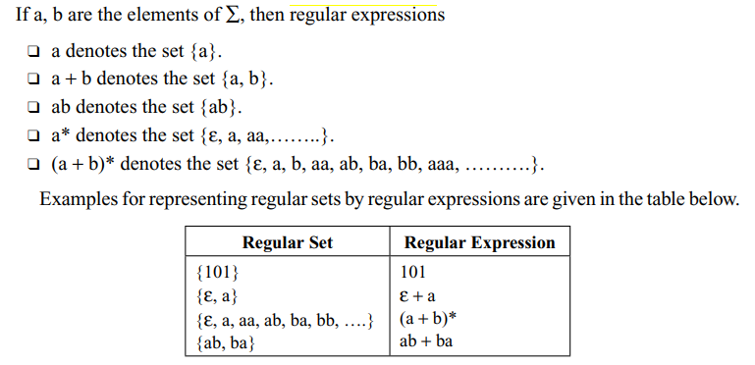
Regular Expression and Regular Set

Slide 3
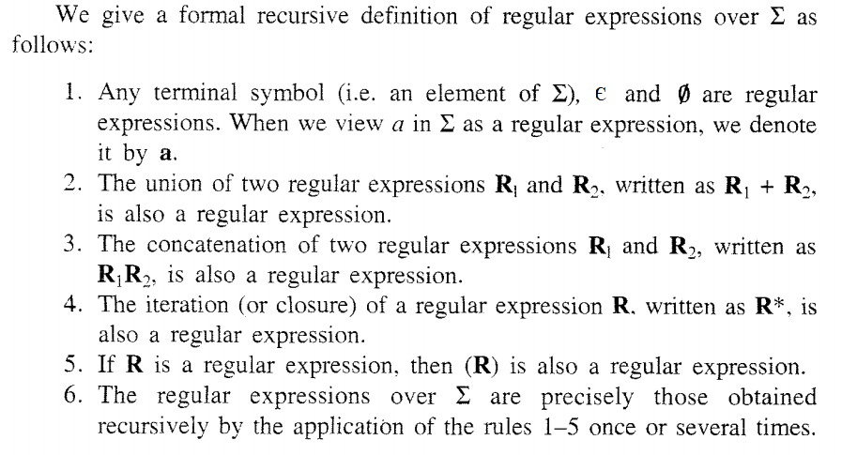
Regular Expression and Regular Set

Slide 4
Regular Expression and Regular Set
Examples:
If ∑={a,b}
a is a regular expression (Rule 1)
є is a regular expression (Rule 1)
Φ is a regular expression (Rule 1)
a + b is a regular expression (Rule 2)
ab is a regular expression (Rule 3)
a * is a regular expression (Rule 4)
(a) is a regular expression (Rule 5)
ab + a * b* is a regular expression (Rule 6)

Slide 5
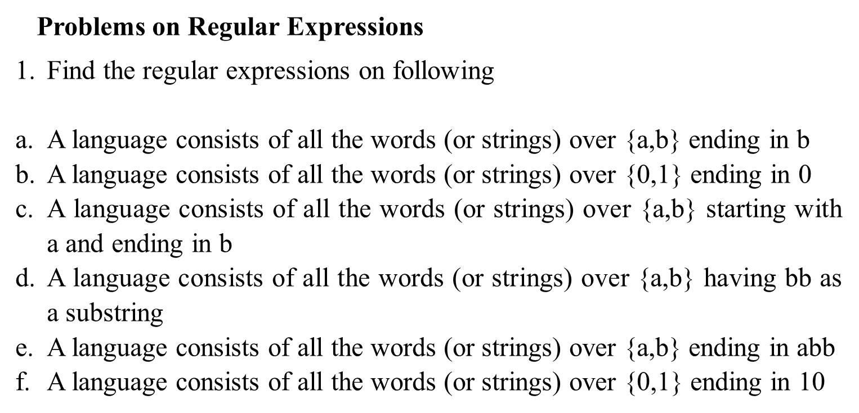
Regular Expression and Regular Set

Slide 6
Regular Expression and Regular Set
Problems on Regular Expressions

Slide 7
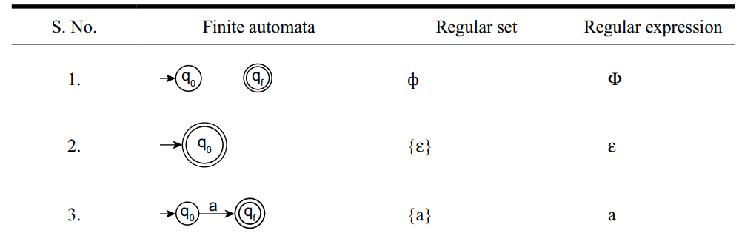
Constructing a Finite Automata for a Regular Expression

Slide 8
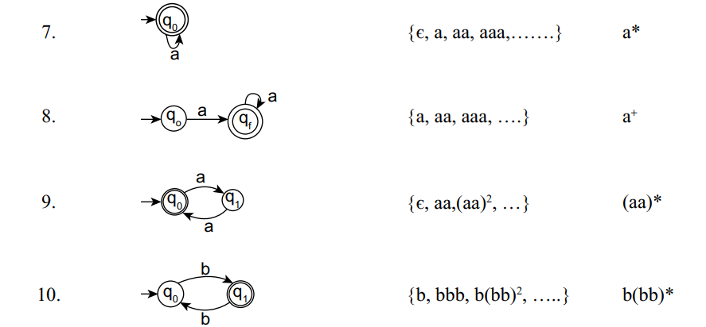
Constructing a Finite Automata for a Regular Expression

